Slide 1

Results the image
[2021.07.15]
Xusong Zhang

Slide 2
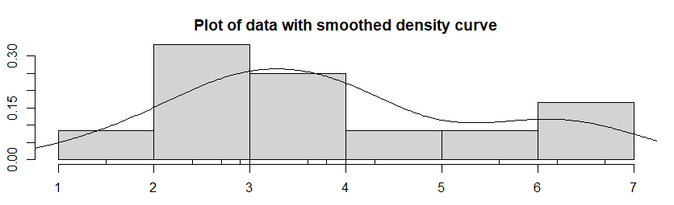
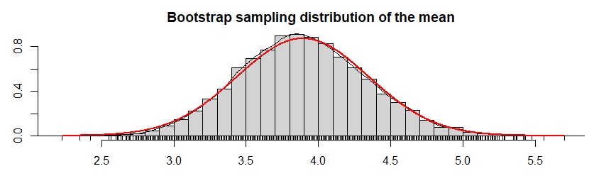
Page 70 to 71 Results

Slide 3
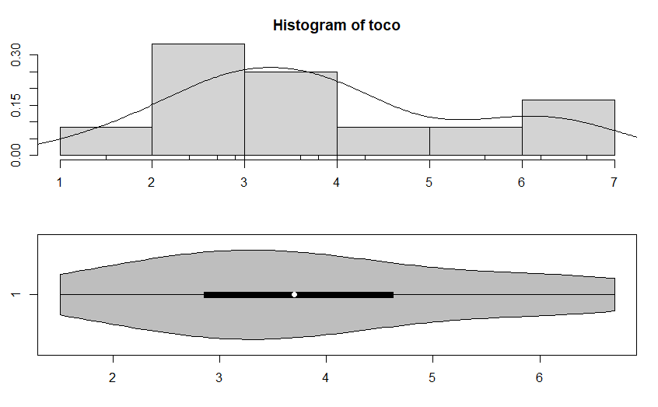
Page 78 to 81 Results

Slide 4
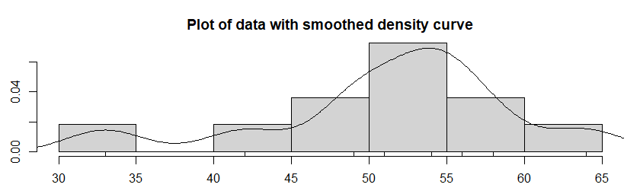
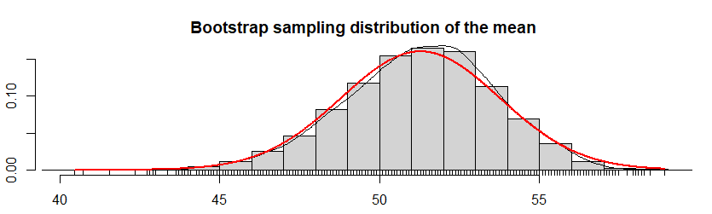
Page 78 to 81 Results

Slide 5
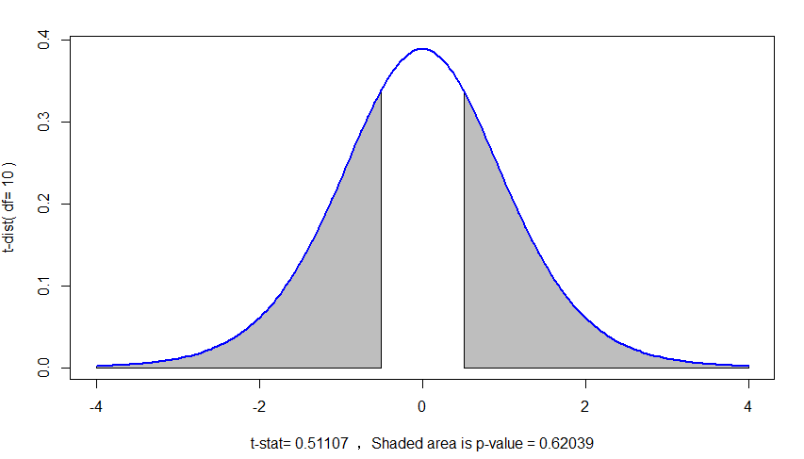
Page 78 to 81 Results

